Slide 1
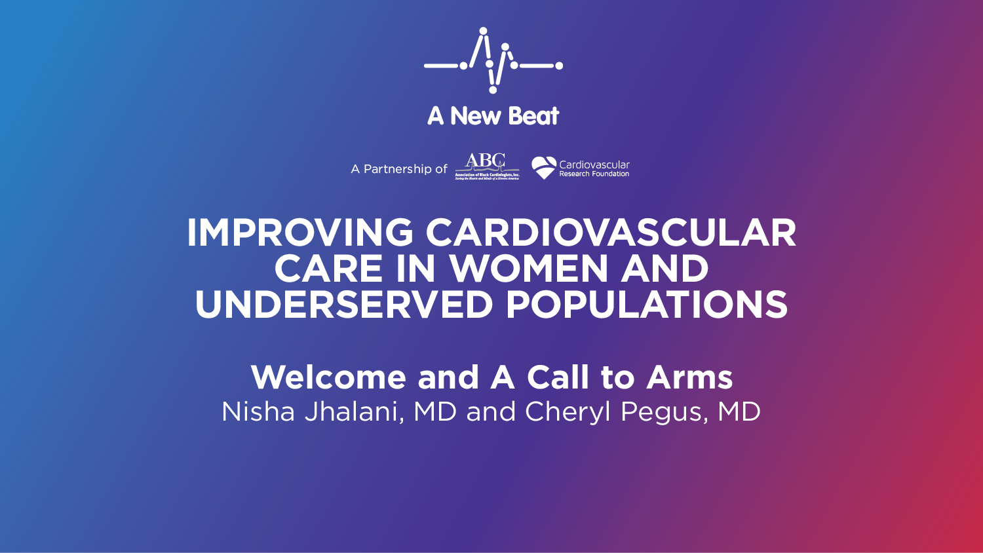
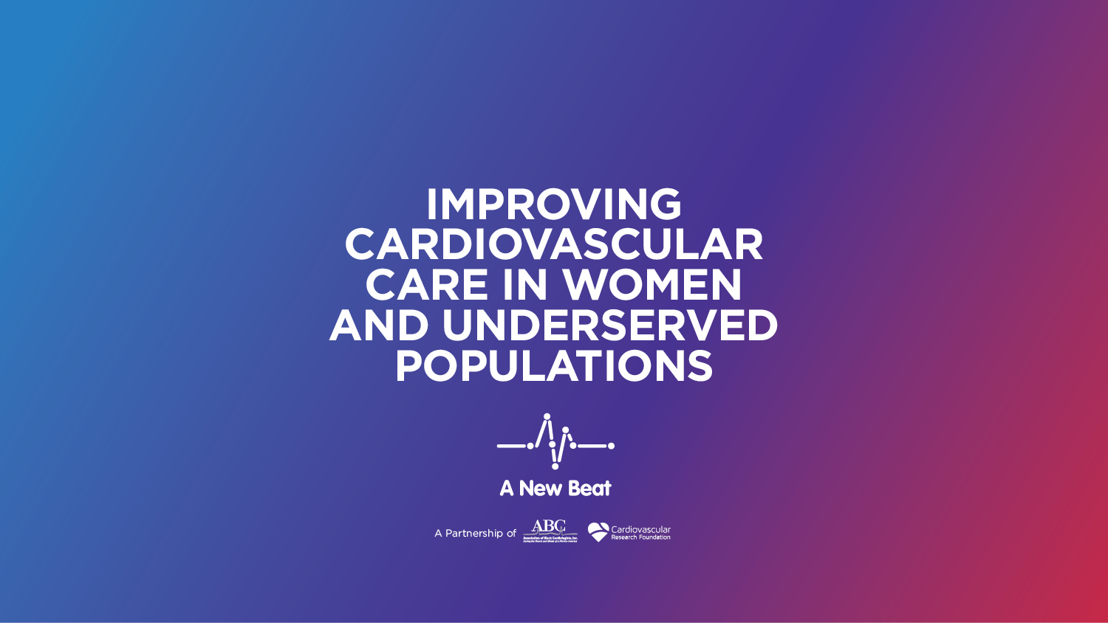

Slide 2
“Time to Stop Passing the Buck:
What Every Cardiologist in 2019 Needs to Know About
Cardiometabolic Risk Reduction and the Treatment of Diabetes Mellitus”
May 30, 2019
New York City, NY
Keith C. Ferdinand, MD, FACC, FAHA, FASH, FNLA
Gerald S. Berenson Endowed Chair in Preventive Cardiology
Professor of Medicine
Tulane University School of Medicine
Tulane Heart and Vascular Institute
New Orleans, LA

Slide 3
Keith C. Ferdinand, MD
Has disclosed the following affiliations.
Any real or apparent COIs related to the presentation
have been resolved.
Speaker’s Bureau- None
Consultant- Amgen, Sanofi, Boehringer Ingelheim, Novartis, Quantum Genomics
Stocks- None
Patents- None

Slide 4
DM and CV Risk
Heart disease rates with DM are 2-4X than without DM
CV death is ↑by 50% with DM
DM ↑stroke, with RR from 1.8 – 6X increased risk
HF event rate is > any other ACS complication with DM
DM men and women ≥50 years of age live an average of 7.5 and 8.2 years less than nondiabetic equivalents.
1. Go AS, Mozaffarian D, Roger VL, et al.; on behalf of the American Heart Association Statistics Committee and Stroke Statistics Subcommittee. Circulation. 2014;129:e28–e292. 2. Franco OH, Steyerberg EW, Hu FB, Mackenbach J, Nusselder W. Arch Intern Med. 2007;167:1145–1151; 3. Malmberg K et al. Circulation. 2000;102:1014-1019.

Slide 5
Age-adjusted prevalence of physician-diagnosed DM in adults ≥20 years of age by race/ethnicity and sex
NHANES 2011-2014 Benjamin,E. et al; AHA STATISTICAL UPDATE Circulation. 2017;135

Slide 6
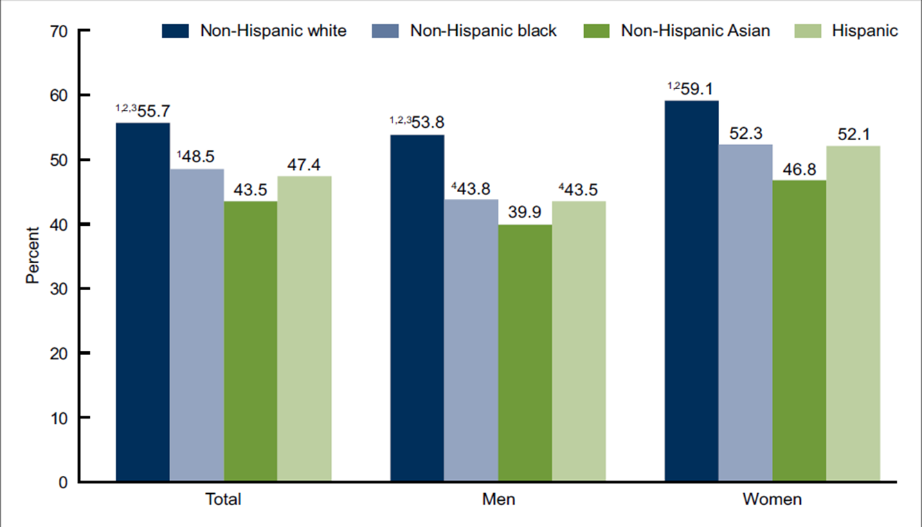
Prevalence Controlled HTN Aged≥18, By Sex, Race and Hispanic Origin
Million Hearts 65%
¹Significant difference from non-Hispanic Asian. ²Significant difference from non-Hispanic white. ³Significant difference from Hispanic.
⁴Significant difference from women in same race and Hispanic origin group.
Yoon SS, et al. NCHS data brief, no 220. Hyattsville, MD: National Center for Health Statistics, 2015. CDC/NCHS, NHANES, 2011-2014.

Slide 7
CV Risk is Not Well-Managed Despite Improvements
% meeting ABC(A1C, BP, cholesterol goals
adults ≥20 years with diagnosed DM, 1988–2010
100
90
80
1988–1994 1999–2002 2003–2006 2007–2010
70
60
50
Percentage (%)
40
30
20
10
0
A1C <7.0%
A1C <8.0%
BP
<130/80 mmHg
BP
<140/90 mmHg
LDL
<100 mg/dL
On Statin
A1C <7.0%,
BP <130/80 mmHg, and LDL <100 mg/dL
Stark Casagrande S, et al. Diabetes Care. 2013;36;2271–2279.

Slide 8
Cardiologists see more patients with T2D than endocrinologists
Yale New Haven Hospital during 2017.
N=78,878 T2D (mean age, 66.7 years; 51% women)
Cardiologist: endocrinologist outpatient encounter 2.6X (51,954 vs 20,337) with lone T2D
5.3X with T2D and CVD.
HF the greatest outpatient encounter ratio (8.4X)
Gunawan F, et al. SUN-149.The Endocrine Society Annual Meeting; March 23-26, 2019

Slide 9
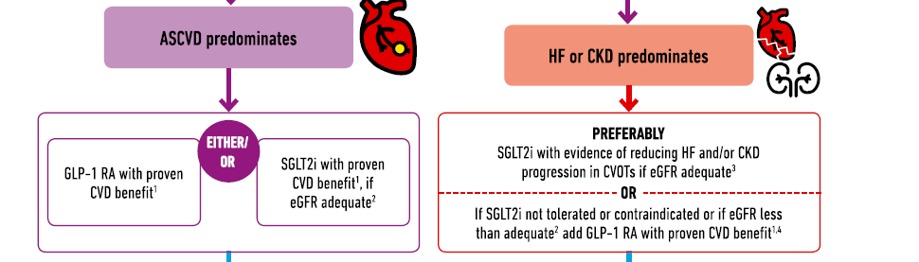
2018 ACC Expert Consensus Decision Pathway on Novel Therapies for CVD Reduction
Das et al. CVD Risk Reduction in T2D Pathway JACC 2018

Slide 10

THANK YOU!

