Slide 1
TAVR in Women and Minorities
Mayra Guerrero MD
Department of Cardiovascular Medicine
Mayo Clinic
A New Beat
New York, NY
May 30th, 2019

Slide 2
Disclosure Statement of Financial Interest
Within the past 12 months, I or my spouse/partner have had a financial interest/arrangement or affiliation with the organization(s) listed below.
Affiliation/Financial Relationship
Company
Research Grant Support, Proctor
Edwards Lifesciences

Slide 3
Aortic Stenosis Gender Differences
Female patients are older
In Sweden (1989-2009):¹
Males 54.7% vs 45.3%
If <75 years of age >60% men,
If >75 years >50% women
Female patients have higher surgical risk profile²
1.- Mafrtinsson, et al. Circulation 2015:131:988-994.
2.- Thourani et al. Ann Thorac Surg 2015;99:55-61.

Slide 4
Female Patients in TAVR Trials
 | TAVR | SAVR or comparator
PARTNER I Extreme risk ¹ | 54.2% | 53.1% Med Rx
PARTNER I High Risk ² | 42.2% | 43.3% SAVR
PARTNER IIA Intermediate risk ³ | 45.8% | 45.2% SAVR
CoreValve Extreme risk ⁴ | 52.1%
SURTAVI Intermediate Risk ⁵ | 42.2% | 45% SAVR
REPRISE High or Extreme Risk ⁵ | 50.1% Lotus | 52.1% CoreValve
NOTION low risk ⁷ | 46.2% | 47.4% SAVR
¹ Leon et all, NEJM 2010
² Smith et al, NEJM 2011
³ Leon et al, NEJM 2016
⁴ Popma et al, JACC 2014
⁵ Reardon NEJM 2017
⁶ Feldman et al, JAMA 2017
⁷ Sondergaard et al, TVT 2018
More female patients in extreme high risk trials

Slide 5
TAVR Outcomes in High Risk Female Patients
Female vs Male
 | % | Age | STS PROM | Bleeding | Vascular complications | 30-Day Mortality | 1-year Mortality
TVT 2011-2014 ¹ n=23,652 | 49.9% | 82.2 vs 81.6 p<0.0001 | 9% vs 8% p<0.0001 | 8 vs 5.9% p= 0.06 | 8.27 vs 4.39% p<0.0001 | In-hosp 5.6 vs 4.28% p=0.29 | 21.3 vs 24.5% p<0.001
PARTNER I ² n=2,559 | 47.7% | 84.9 vs 84.1 | 11.9 vs 11.1% | 10.5 vs 7.7% p=0.012 | 17.3 vs 10% p < 0.001 | 6.48 vs 5.9% p=0.52 | 19 vs 25.9% p<0.001
US CoreValve Trials ³ n=3,687 | 46.3% | 84 vs 82.7 p <0.01 | 9.6 vs 8.3% p <0.01 | 29.7 vs 21.7% p <0.01 | 9.7% vs 4.9% p <0.01 | 5.8 vs 5.9% p= 0.87 | 21.3 vs 24.1% p=0.08
REPRISE III ⁴ n=874 | 50% | 83.2 vs 82.3 p= 0.07 | 7.9 vs 5.7% p <0.01 | 20 vs 15% p=0.05 | 8.2 vs 4.7% p=0.04 | 3.2 vs 2.8% p=0.69 | 12.1 vs 11.9 p=0.98
WIN-TAVI ⁵ n=1,010 | 100% | 82.5 | 8.3% (±7.4) | 7.7% | 7.7% | 3.4% | NA
¹ Chandrasekhar et all, JACC 2016
² Kodali et al, Ann Intern Med 2016
³ Forrest et al, Am J Cardiol 2016
⁴ Guerrero et al, EuroPCR 2018
⁵ Chieffo et al, JACC Interv 2016
The Women Paradox:
Higher risk profile, more bleeding and vascular complications…
Equal or lower mortality than men

Slide 6
TAVI Outcomes in High Risk Female Patients
Female vs Male
 | % | Age | STS PROM | Bleeding | Vascular complications | 30-Day Mortality | 1-year Mortality
TVT 2011-2014 ¹ n=23,652 | 49.9% | 82.2 vs 81.6 p<0.0001 | 9% vs 8% p<0.0001 | 8 vs 5.9% p= 0.06 | 8.27 vs 4.39% p<0.0001 | In-hosp 5.6 vs 4.28% p=0.29 | 21.3 vs 24.5% p<0.001
PARTNER I ² n=2,559 | 47.7% | 84.9 vs 84.1 | 11.9 vs 11.1% | 10.5 vs 7.7% p=0.012 | 17.3 vs 10% p < 0.001 | 6.48 vs 5.9% p=0.52 | 19 vs 25.9% p<0.001
US CoreValve Trials ³ n=3,687 | 46.3% | 84 vs 82.7 p <0.01 | 9.6 vs 8.3% p <0.01 | 29.7 vs 21.7% p <0.01 | 9.7% vs 4.9% p <0.01 | 5.8 vs 5.9% p= 0.87 | 21.3 vs 24.1% p=0.08
REPRISE III ⁴ n=874 | 50% | 83.2 vs 82.3 p= 0.07 | 7.9 vs 5.7% p <0.01 | 20 vs 15% p=0.05 | 8.2 vs 4.7% p=0.04 | 3.2 vs 2.8% p=0.69 | 12.1 vs 11.9 p=0.98
WIN-TAVI ⁵ n=1,010 | 100% | 82.5 | 8.3% (±7.4) | 7.7% | 7.7% | 3.4% | NA
¹ Chandrasekhar et all, JACC 2016
² Kodali et al, Ann Intern Med 2016
³ Forrest et al, Am J Cardiol 2016
⁴ Guerrero et al, EuroPCR 2018
⁵ Chieffo et al, JACC Interv 2016
The Women Paradox:
Higher risk profile, more bleeding and vascular complications…
Equal or lower mortality than men

Slide 7
TAVI Outcomes in High Risk Female Patients
Female vs Male
 | % | Age | STS PROM | Bleeding | Vascular complications | 30-Day Mortality | 1-year Mortality
TVT 2011-2014 ¹ n=23,652 | 49.9% | 82.2 vs 81.6 p<0.0001 | 9% vs 8% p<0.0001 | 8 vs 5.9% p= 0.06 | 8.27 vs 4.39% p<0.0001 | In-hosp 5.6 vs 4.28% p=0.29 | 21.3 vs 24.5% p<0.001
PARTNER I ² n=2,559 | 47.7% | 84.9 vs 84.1 | 11.9 vs 11.1% | 10.5 vs 7.7% p=0.012 | 17.3 vs 10% p < 0.001 | 6.48 vs 5.9% p=0.52 | 19 vs 25.9% p<0.001
US CoreValve Trials ³ n=3,687 | 46.3% | 84 vs 82.7 p <0.01 | 9.6 vs 8.3% p <0.01 | 29.7 vs 21.7% p <0.01 | 9.7% vs 4.9% p <0.01 | 5.8 vs 5.9% p= 0.87 | 21.3 vs 24.1% p=0.08
REPRISE III ⁴ n=874 | 50% | 83.2 vs 82.3 p= 0.07 | 7.9 vs 5.7% p <0.01 | 20 vs 15% p=0.05 | 8.2 vs 4.7% p=0.04 | 3.2 vs 2.8% p=0.69 | 12.1 vs 11.9 p=0.98
WIN-TAVI ⁵ n=1,010 | 100% | 82.5 | 8.3% (±7.4) | 7.7% | 7.7% | 3.4% | NA
¹ Chandrasekhar et all, JACC 2016
² Kodali et al, Ann Intern Med 2016
³ Forrest et al, Am J Cardiol 2016
⁴ Guerrero et al, EuroPCR 2018
⁵ Chieffo et al, JACC Interv 2016
The Women Paradox:
Higher risk profile, more bleeding and vascular complications…
Equal or lower mortality than men

Slide 8
TAVI Outcomes in High Risk Female Patients
Female vs Male
 | % | Age | STS PROM | Bleeding | Vascular complications | 30-Day Mortality | 1-year Mortality
TVT 2011-2014 ¹ n=23,652 | 49.9% | 82.2 vs 81.6 p<0.0001 | 9% vs 8% p<0.0001 | 8 vs 5.9% p= 0.06 | 8.27 vs 4.39% p<0.0001 | In-hosp 5.6 vs 4.28% p=0.29 | 21.3 vs 24.5% p<0.001
PARTNER I ² n=2,559 | 47.7% | 84.9 vs 84.1 | 11.9 vs 11.1% | 10.5 vs 7.7% p=0.012 | 17.3 vs 10% p < 0.001 | 6.48 vs 5.9% p=0.52 | 19 vs 25.9% p<0.001
US CoreValve Trials ³ n=3,687 | 46.3% | 84 vs 82.7 p <0.01 | 9.6 vs 8.3% p <0.01 | 29.7 vs 21.7% p <0.01 | 9.7% vs 4.9% p <0.01 | 5.8 vs 5.9% p= 0.87 | 21.3 vs 24.1% p=0.08
REPRISE III ⁴ n=874 | 50% | 83.2 vs 82.3 p= 0.07 | 7.9 vs 5.7% p <0.01 | 20 vs 15% p=0.05 | 8.2 vs 4.7% p=0.04 | 3.2 vs 2.8% p=0.69 | 12.1 vs 11.9 p=0.98
WIN-TAVI ⁵ n=1,010 | 100% | 82.5 | 8.3% (±7.4) | 7.7% | 7.7% | 3.4% | NA
¹ Chandrasekhar et all, JACC 2016
² Kodali et al, Ann Intern Med 2016
³ Forrest et al, Am J Cardiol 2016
⁴ Guerrero et al, EuroPCR 2018
⁵ Chieffo et al, JACC Interv 2016
The Women Paradox:
Higher risk profile, more bleeding and vascular complications…
Equal or lower mortality than men

Slide 9
TAVI Outcomes in High Risk Female Patients
Female vs Male
 | % | Age | STS PROM | Bleeding | Vascular complications | 30-Day Mortality | 1-year Mortality
TVT 2011-2014 ¹ n=23,652 | 49.9% | 82.2 vs 81.6 p<0.0001 | 9% vs 8% p<0.0001 | 8 vs 5.9% p= 0.06 | 8.27 vs 4.39% p<0.0001 | In-hosp 5.6 vs 4.28% p=0.29 | 21.3 vs 24.5% p<0.001
PARTNER I ² n=2,559 | 47.7% | 84.9 vs 84.1 | 11.9 vs 11.1% | 10.5 vs 7.7% p=0.012 | 17.3 vs 10% p < 0.001 | 6.48 vs 5.9% p=0.52 | 19 vs 25.9% p<0.001
US CoreValve Trials ³ n=3,687 | 46.3% | 84 vs 82.7 p <0.01 | 9.6 vs 8.3% p <0.01 | 29.7 vs 21.7% p <0.01 | 9.7% vs 4.9% p <0.01 | 5.8 vs 5.9% p= 0.87 | 21.3 vs 24.1% p=0.08
REPRISE III ⁴ n=874 | 50% | 83.2 vs 82.3 p= 0.07 | 7.9 vs 5.7% p <0.01 | 20 vs 15% p=0.05 | 8.2 vs 4.7% p=0.04 | 3.2 vs 2.8% p=0.69 | 12.1 vs 11.9 p=0.98
WIN-TAVI ⁵ n=1,010 | 100% | 82.5 | 8.3% (±7.4) | 7.7% | 7.7% | 3.4% | NA
¹ Chandrasekhar et all, JACC 2016
² Kodali et al, Ann Intern Med 2016
³ Forrest et al, Am J Cardiol 2016
⁴ Guerrero et al, EuroPCR 2018
⁵ Chieffo et al, JACC Interv 2016
The Women Paradox:
Higher risk profile, more bleeding and vascular complications…
Equal or lower mortality than men

Slide 10
If female patients have
higher surgical risk
and better outcomes
with TAVR
TAVR for all women with symptomatic AS
+
=
Is this what happens in real practice?
If not, How can we help more women get treated with TAVR?

Slide 11
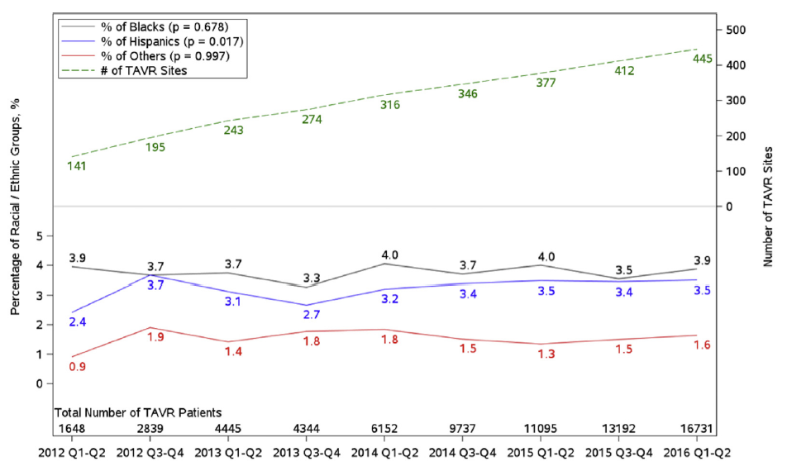
TVT Registry
70,221 patients treated between 2011 and 2016 (47.7% female)
91.3% white (47% F), 3.8% black (60.7% F), 3.4% Hispanic (51,7% F) and 1.5% Asian/Native American (48.3%)
Alkhouli, et al. JACC Interv 2019:12:936-48

Slide 12
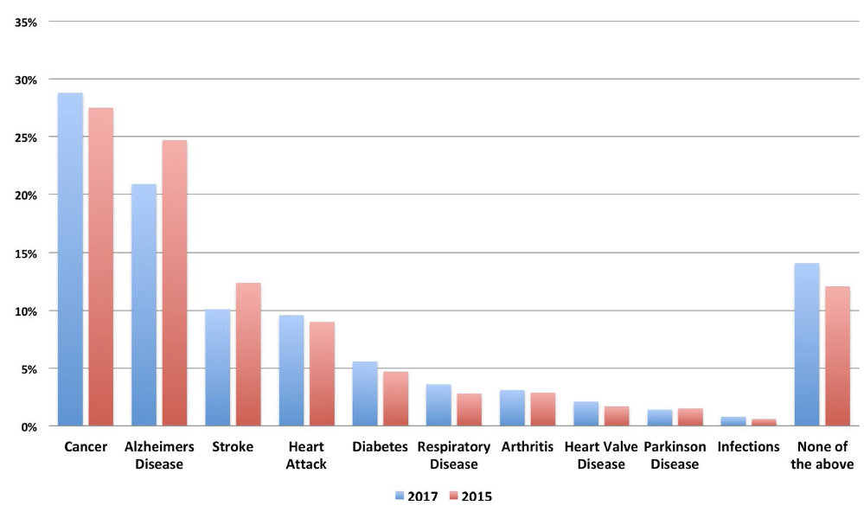
Awareness in General Population
n=12,820 people 60 years of older at 11 European countries
Luise, et al. Clin Res Cardiol 2018.

Slide 13
Aortic Stenosis in Women Summary
Incidence similar to men but clinical presentation at a later age
Higher surgical risk than men
Higher risk profile in TAVR compared with men (age, comorbidities, smaller anatomy)
Similar or better clinical outcomes after TAVR compared with men
Unanswered
What percentage of women globally are treated with SAVR vs TAVR ?
Percentage of untreated patients?

Slide 14
Strategies to decrease burden of AS in women and minorities
Increase awareness in general population
Modify risk factors to decrease incidence and/or delay onset
Early treatment to decrease morbidity and mortality
Treat women with TAVR instead of SAVR
Barriers
Access to health care
Referral bias
Need more female cardiologists?

Slide 15
Thank You guerrero.mayra@mayo.edu mayraguerrero@me.com

